Slide 1


Introduction to entire course

Slide 2

Walkthrough the Java with DSA and System Design

Slide 3
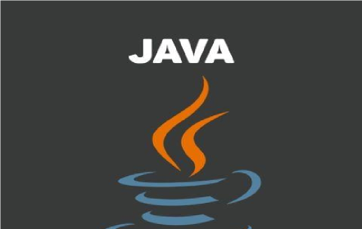
Getting Started with Java Fundamental
1. Fundamentals of Computer
2. Fundamentals of Java Programming (Variables, data types, operators and Conditionals).
Main method in Java.
Loops & Logic building with pattern programmings and Java Objects and Methods
Array in Java.
Strings in Java.

Slide 4

Core Java
Constructor
Static keyword.
Encapsulation
Inheritance
Polymorphism
Abstraction.
Interface

Slide 5
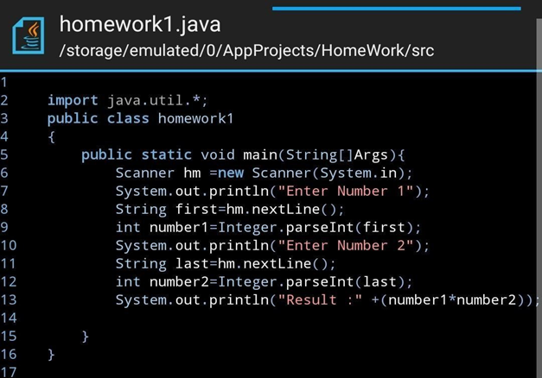
Advanced Java Concept
Exception Handling
MultiThreading
Collection FrameWork
Map API in java
Lambda Expression
Generic And Annotation
Stream API
File Handling

Slide 6

Version Control Systems (VCSs)
Introduction to version control systems (Git)
Introduction to GitHub
Git Architecture
Basic Git Commands
Git EcoSystem
Git Branch

Slide 7
Concept In DSA(Data Structure and Algorithms)
Complexity Analysis and Array
Recursion
Sorting,Searching and Bit Manipulation
BackTracking
Linked List
HashMap,Stack and Queue
Divide and Conquer, Greedy Approach
Tree
Binary Search Tree
Priority Queue
Graph
Dynamic Programming

Slide 8

System Design
Design Principles.
System Design.

Slide 9

Walkthrough with the Application Development

Slide 10
Database Concepts
SQL(MySQL)
NoSQL(MongoDB)

Slide 11
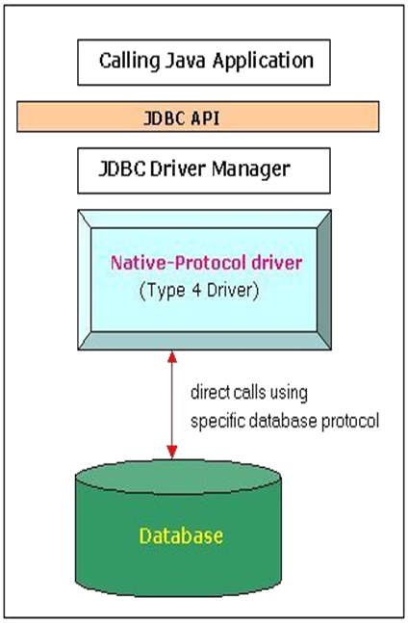
JDBC
Introduction to JDBC
Steps Involved in JDBC.
CRUD Operation in JDBC.
Servlets
Client Server Architecture
Servlet life cycle
Servlet Application with MVC Design Pattern

Slide 12
Application Development using Framework
Hibernate Features
Hibernate Architecture
Connection Pooling in Hibernate
Caching in hibernate
Spring fundamentals
Spring Boot
Spring Data JPA
Spring REST

Slide 13
Project Development

Slide 14
THANK YOU

